Slide 1
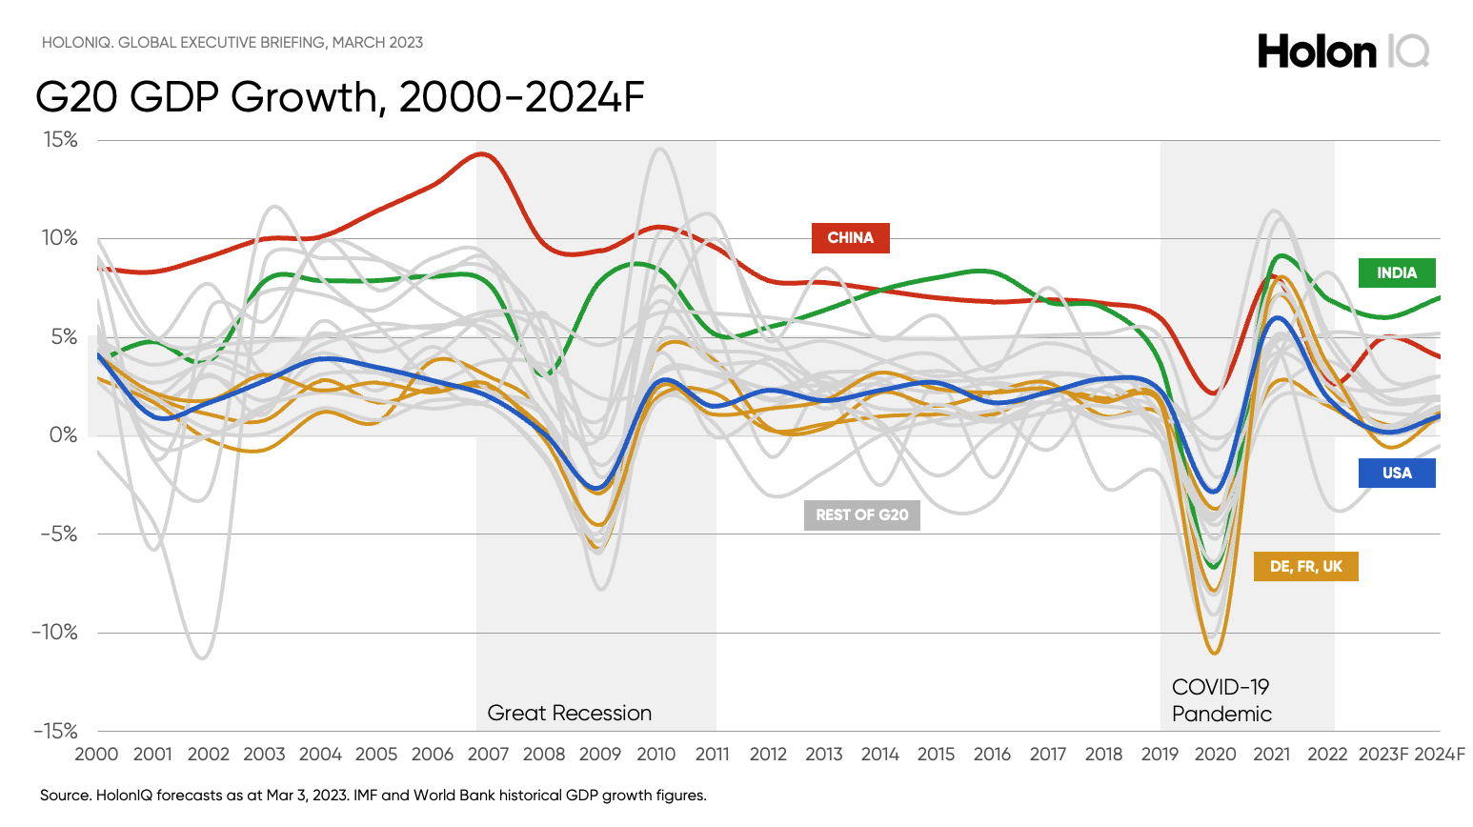

Slide 2
Looking over the horizon, China will overtake the US and become the world's largest economy around 2035 with India overtaking the US around 2075.

Slide 3
From the G7 to the G20

Slide 4
The last quarter of the 20th century saw a massive expansion of formal and informal intergovernmental consultation bodies with a goal of global economic stability. Their origin lay in the small but select informally G7.

Slide 5
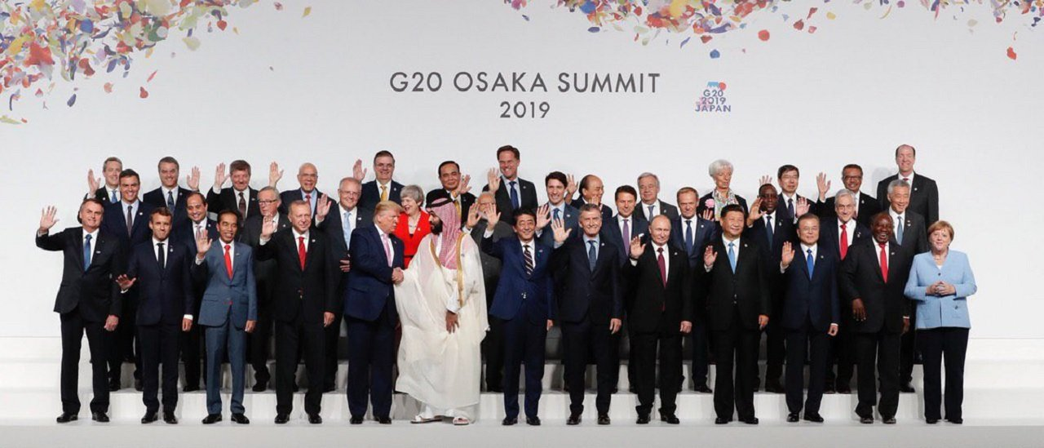
Economic Integration
the G20 is up. It is made up of 19 countries plus the European Union. Together, these countries globally account for 90% of gross national product, 80% of world trade and 75% of the world population.

Slide 6
Definition and forms of economic integration
Unlike transactions within the same country, international transactions face barriers as a result of:
Economic borders.
Associated with protectionist policies that discriminate against foreign products in favor of national ones.
The diversity of currencies.
Which forces a currency exchange in markets subject to uncertainties and costs.
Restrictions on the mobility of factors.
Specific micro and macroeconomic policies for national industries
Economic integration aims to eliminate those differential characteristics

Slide 7
Definition and forms of economic integration
There are different modalities of economic integration according to the type of barrier to international transactions that is being eliminated
DENOMINATION | DESCRIPTION
Preferential agreements | Countries grant each other a series of preferences (reduction of tariffs or other forms of protection)." This is often part of the structure of preferential trade agreements.
Free Trade Area (FTA) | Member countries eliminate tariffs among themselves, but maintain their own trade policy towards third parties
Custom Union | It implies the elimination of tariffs and the establishment of a common external tariff
Common Market | In addition to the free movement of goods and services, it includes the free movement of labor and capital
Economic Union | Implies the coordination of economic policies. This is typically in reference to the efforts within an economic union to harmonize fiscal, monetary, and other economic policies among member countries.
Monetary Union | Includes the adoption of a single currency

Slide 8
Definition and forms of economic integration
The motivations that lead countries to undertake these processes are of various kinds:
Economic
Markets are expanded.
Competition increases.
This helps to accelerate the rate of growth.
Political
The intersection of economic interests helps to reduce tensions and confrontations between countries.
An integrated area carries more weight on the international stage.
It helps to find joint solutions to global problems (environmental, migratory, etc.
Security

Slide 9
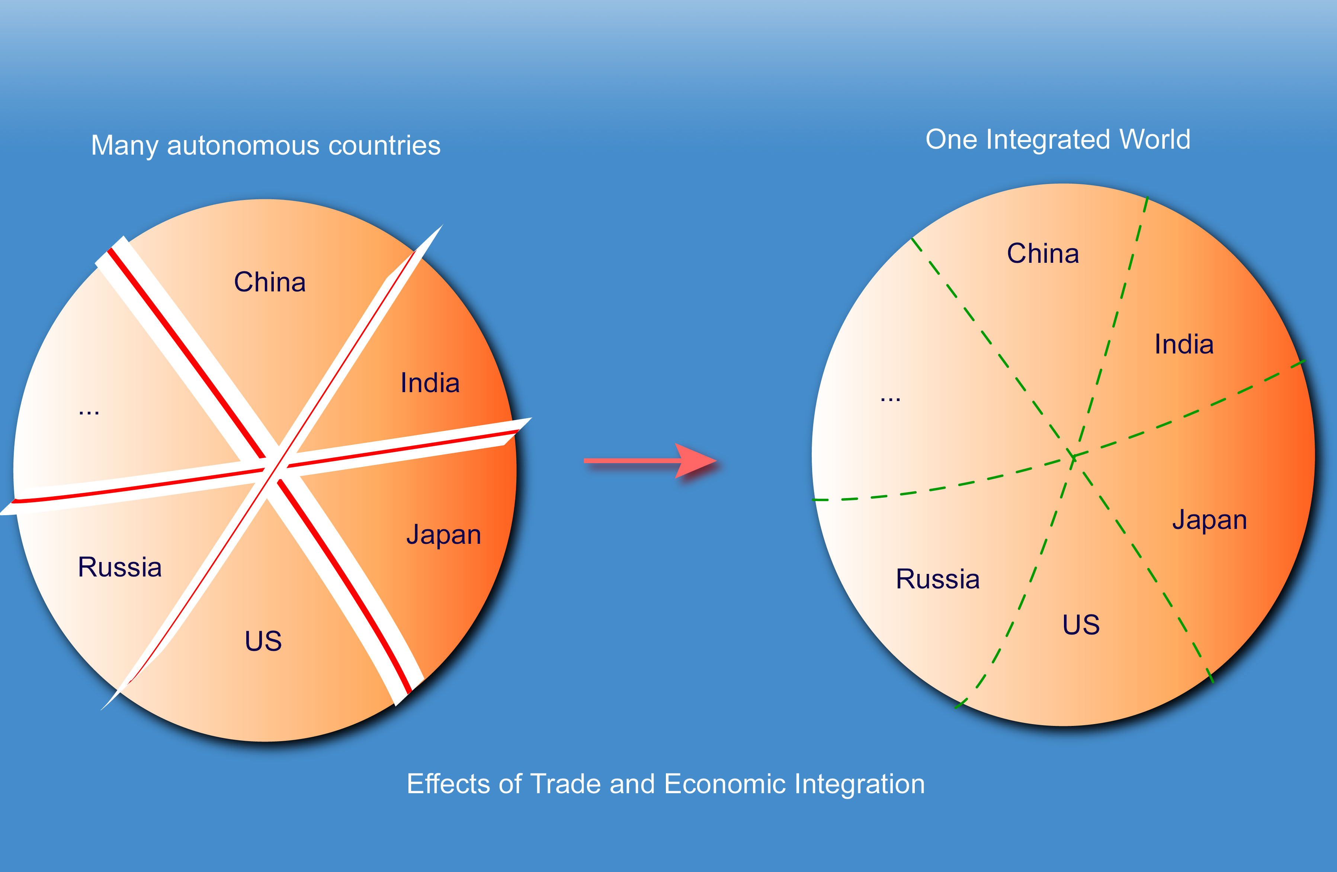
Economic Integration

Slide 10
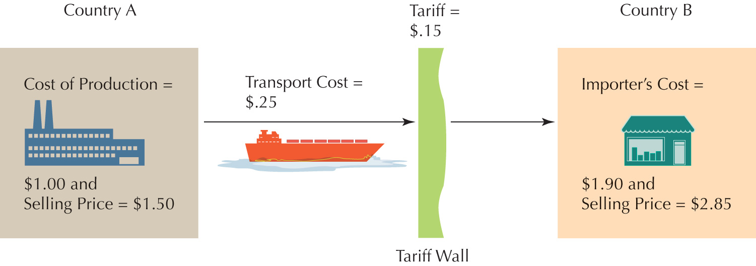
Economic Integration
Price Escalation in Exporting if Companies Use Cost-plus Pricing
1) Please calculate the benefit of the country A and B ??
2) Please include the economic integration and calculate the new benefit for the importer
3) What kind of agreement could you find between the seller A and the buyer B?

Slide 11
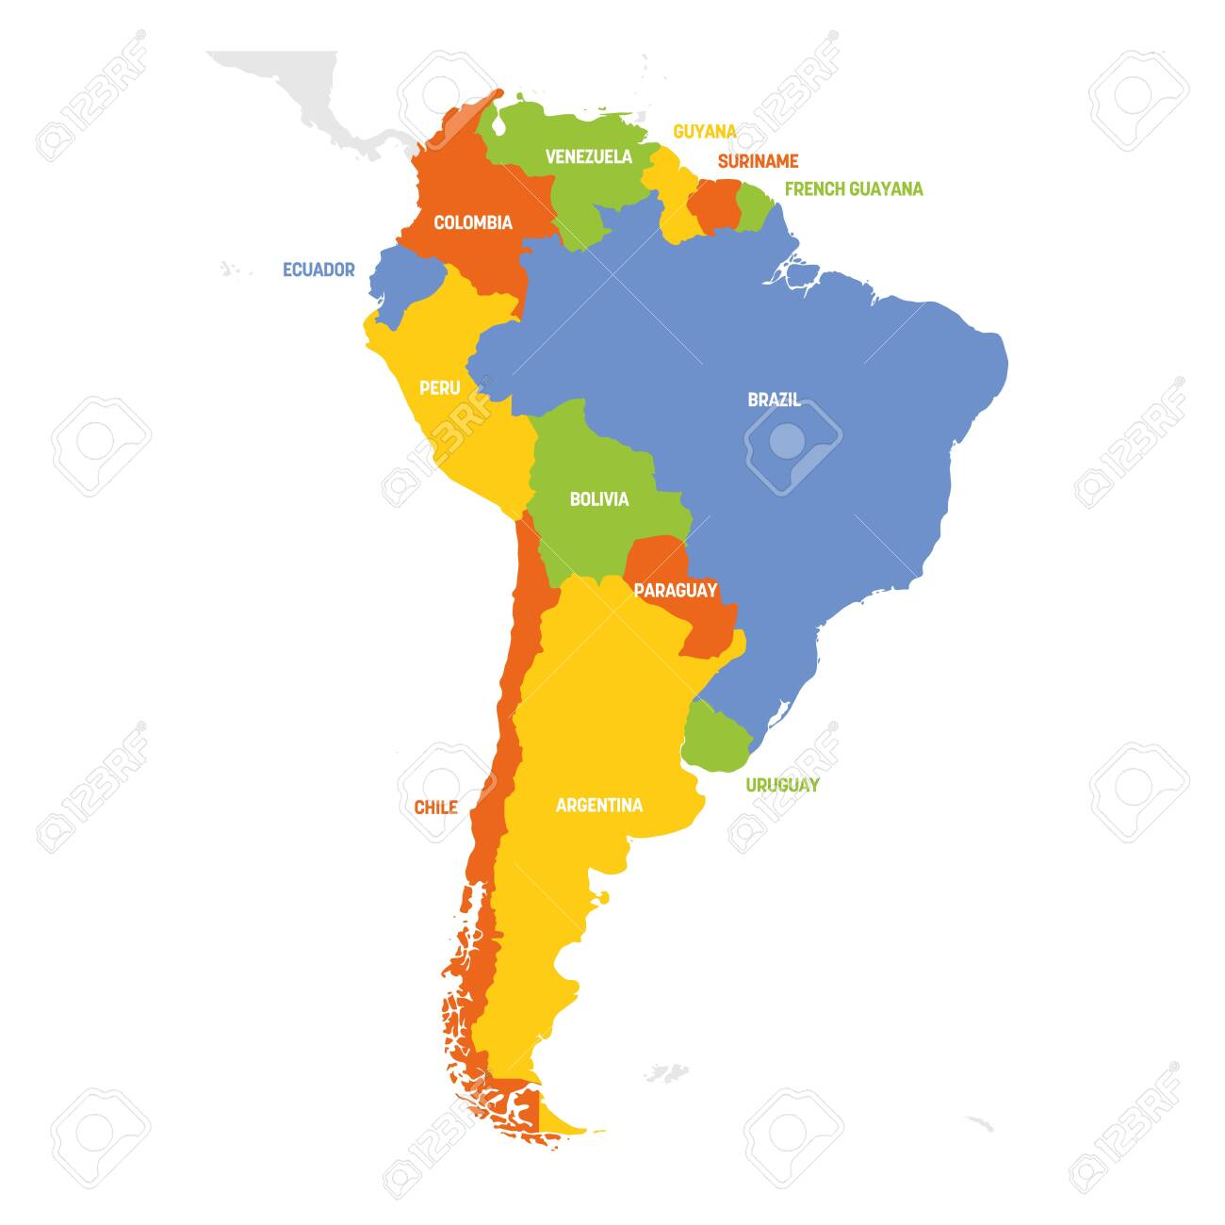
3 Latin America/ South America
Economic forces
South America is the fourth largest continent in the world and covers an area of 6.89 million square miles. The continent is made up of 12 sovereign countries: Colombia, Bolivia, Argentina, Chile, Peru, Uruguay, Brazil, Paraguay, Venezuela, Guyana, Suriname, and Ecuador.
The Southern Common Market (MERCOSUR for its Spanish initials) is a regional integration process, initially established by Argentina, Brazil, Paraguay and Uruguay, Its official working languages are Spanish and Portuguese.

Slide 12


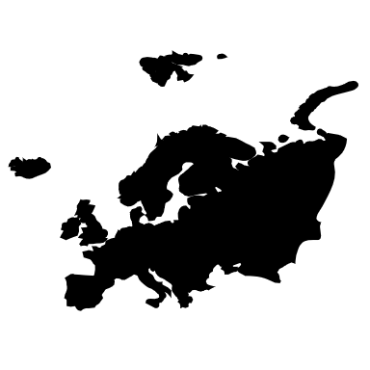
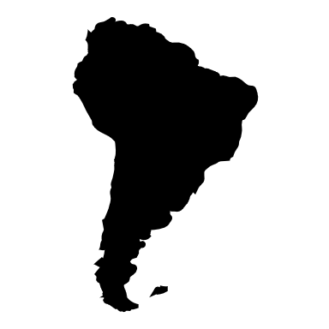
Economic Integration and the International Manager
Cultural and structural changes
4 AXES
Geography
Communication
Law
Culture

